Slide 1
Capstone Projects Involving Computational Physics
Jeffrey W. Emmert
February 20, 2017
Notes:
This template can be used as a starter file for presenting training materials in a group setting.
Sections
Right-click on a slide to add sections. Sections can help to organize your slides or facilitate collaboration between multiple authors.
Notes
Use the Notes section for delivery notes or to provide additional details for the audience. View these notes in Presentation View during your presentation.
Keep in mind the font size (important for accessibility, visibility, videotaping, and online production)
Coordinated colors
Pay particular attention to the graphs, charts, and text boxes.
Consider that attendees will print in black and white or grayscale. Run a test print to make sure your colors work when printed in pure black and white and grayscale.
Graphics, tables, and graphs
Keep it simple: If possible, use consistent, non-distracting styles and colors.
Label all graphs and tables.

Slide 2
Experiment
Physics Research:
Theory
Hypothesize, model, predict
Design, build, observe
Computation
Visualize, simulate
Notes:
Give a brief overview of the presentation. Describe the major focus of the presentation and why it is important.
Introduce each of the major topics.
To provide a road map for the audience, you can repeat this Overview slide throughout the presentation, highlighting the particular topic you will discuss next.

Slide 3
Computation…
Can be used to investigate models and scenarios that are too difficult or time consuming to evaluate by hand
Offers an alternative to real experiments that are too expensive or hazardous to perform
“The purpose of computing is insight, not numbers.” - R. W. Hamming
Notes:
Give a brief overview of the presentation. Describe the major focus of the presentation and why it is important.
Introduce each of the major topics.
To provide a road map for the audience, you can repeat this Overview slide throughout the presentation, highlighting the particular topic you will discuss next.

Slide 4
Why a Computation Capstone Project?
Generally inexpensive, requiring few resources
Can be relatively simple and accessible for undergraduate students
Develops programming skills, which are often useful when students seek employment
Notes:
Give a brief overview of the presentation. Describe the major focus of the presentation and why it is important.
Introduce each of the major topics.
To provide a road map for the audience, you can repeat this Overview slide throughout the presentation, highlighting the particular topic you will discuss next.

Slide 5
Partnership for Integration of Computation into Undergraduate Physics (PICUP)
Seeks to expand the role of computation in the undergraduate physics curriculum
Provides exercise sets that can be downloaded and modified
Offers week-long faculty development workshops
Visit http://www.compadre.org/PICUP/
Notes:
Give a brief overview of the presentation. Describe the major focus of the presentation and why it is important.
Introduce each of the major topics.
To provide a road map for the audience, you can repeat this Overview slide throughout the presentation, highlighting the particular topic you will discuss next.

Slide 6
Recent undergraduate computational physics projects at Salisbury University:
Computer Modeling of Adsorbate Configurations, Lisa Dean and Christian Schwarz
Dynamics of a Double Pendulum with Isosceles Triangle Components, David Binkowski and Zachary Jackson
Packing Disks Optimally, Sarah Confrancisco
Effect of Starting Location on Clusters Formed by Diffusion-Limited Aggregation
Fractals Hidden in the Dynamics of the Compound Double Pendulum
, Louise Coltharp
, May Palace
Faculty mentors include Dr. Jeffrey Emmert and Dr. Gail Welsh
Notes:
Give a brief overview of the presentation. Describe the major focus of the presentation and why it is important.
Introduce each of the major topics.
To provide a road map for the audience, you can repeat this Overview slide throughout the presentation, highlighting the particular topic you will discuss next.

Slide 7
Diffusion-Limited Aggregation
DLA is a growth process
  Initialized by a seed particle
  Cluster forms as additional particles undergo random walks and attach themselves, one-by-one, to the cluster
Random walk step size affects characteristics of the resulting cluster
We chose to create an off-lattice, two-dimensional simulation of DLA using identical particles
Notes:
Emphasize that these images are produced by our program

Slide 8
Starting Location: Common Model
Each particles diffuses from a “birth” circle
The birth circle is kept far from the growing cluster

Slide 9

Starting Location: Random Start
Each particle diffuses from a different random “birth” location near the growing cluster
The birth location may not overlap the existing cluster

Slide 10
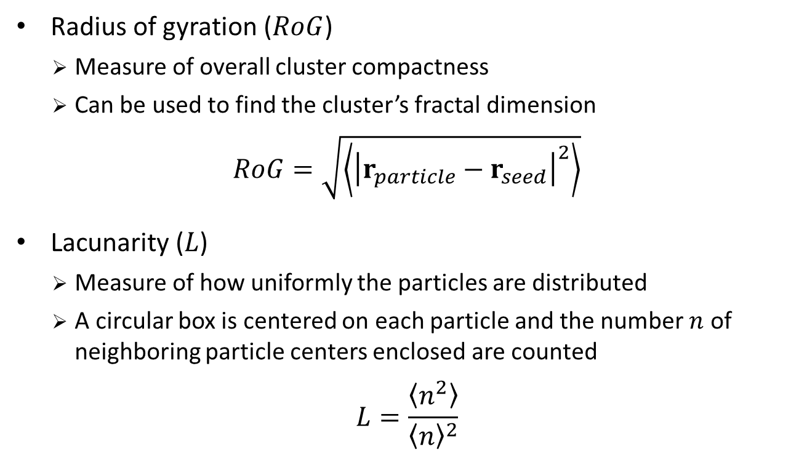
Characterizing the Clusters
Radius of gyration ($RoG$)
  Measure of overall cluster compactness
  Can be used to find the cluster’s fractal dimension
$$RoG=\sqrt{\left\langle {\left|r_{particle}−r_{seed}\right|}^{2}\right\rangle }$$
Lacunarity ($L$)
  Measure of how uniformly the particles are distributed
  A circular box is centered on each particle and the number $n$ of neighboring particle centers enclosed are counted
$$L=\frac{\left\langle n^{2}\right\rangle }{{\left\langle n\right\rangle }^{2}}$$
Notes:
Emphasize that we created the code!
Can get scaling relationship and fractal dim from ROG

Slide 11
Common Model
10⁴ particles per cluster
step size: 2
step size: 8
step size: 32
Random Start
Notes:
We did >1000 clusters, this is a small sample

Slide 12
Common Model
Random Start
10⁴ particles per cluster

Slide 13
Radius of Gyration vs. Step Size (10⁶ particles per cluster)
Average RoG (particle diameters)
Random Walk Step Size (particle diameters)
Notes:
**are these statistically different, the symbols are the “size” of the error bars

Slide 14
Lacunarity vs. Step Size (10⁶ particles per cluster)
Average Lacunarity
Random Walk Step Size (particle diameters)

Slide 15
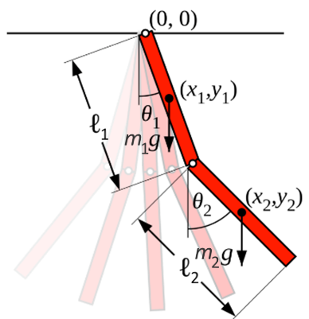
The Compound Double Pendulum
Simple mechanical system
Exhibits rich dynamical behavior that is deterministically chaotic
  Future behavior is fully determined by initial conditions
  Small differences in initial conditions yield widely diverging outcomes
Differential equations of motion can be derived via Lagrangian mechanics
Time evolution found by numerically integrating the equations of motion

Slide 16

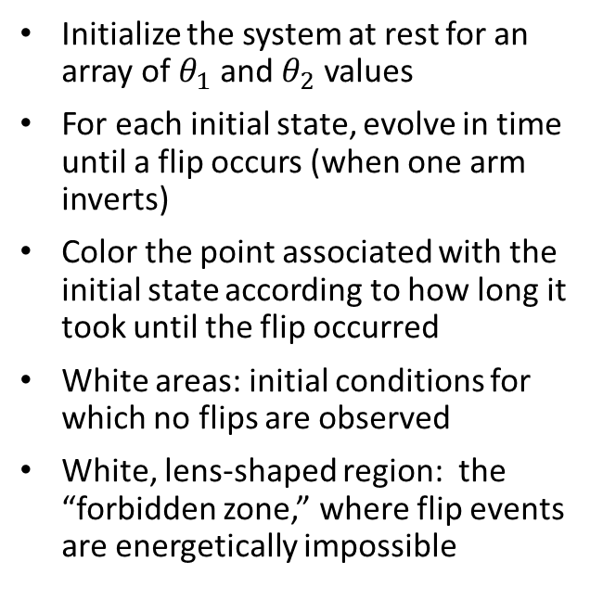
Plotting a “Flip Portrait”
Initialize the system at rest for an array of $θ_{1}$ and $θ_{2}$ values
For each initial state, evolve in time until a flip occurs (when one arm inverts)
Color the point associated with the initial state according to how long it took until the flip occurred
White areas: initial conditions for which no flips are observed
White, lens-shaped region: the “forbidden zone,” where flip events are energetically impossible
double-rod pendulum with $m_{1}=m_{2}$ and $l_{1}=l_{2}$

Slide 17
Primary vs. Secondary Flips
double-rod pendulum with $m_{1}=m_{2}$ and $l_{1}=l_{2}$

Slide 18



Three Cases of Pendulum Parameters
Secondary arm first-flip portraits:
$$l_{1}=l_{2}$$
$$3l_{1}=l_{2}$$
$$4l_{1}=l_{2}$$
double-rod pendula with $m_{1}=m_{2}$

Slide 19
References:
R. W. Hamming, Numerical Methods for Scientists and Engineers (McGraw-Hill Book Company, 1962).
J. S. Heyl, The Double Pendulum Fractal, August 2008 (unpublished).
P. Meakin, Fractals, Scaling, and Growth Far from Equilibrium (Cambridge University Press, 1998).
E. P. Rodrigues, M. S. Barbosa, and L. da F. Costa, Phys. Rev. E 72, 16707 (2005).
S. Strogatz, Nonlinear Dynamics and Chaos (Perseus Books Publishing, 1994).
T. A. Witten, Jr and L. M. Sander, Phys. Rev. Lett. 47, 1400 (1981).
Notes:
Give a brief overview of the presentation. Describe the major focus of the presentation and why it is important.
Introduce each of the major topics.
To provide a road map for the audience, you can repeat this Overview slide throughout the presentation, highlighting the particular topic you will discuss next.

